Slide 1

Enterprise Knowledge Base: Key Stats
Enterprise knowledge bases are becoming increasingly popular as businesses strive to improve efficiency, reduce costs, and enhance employee productivity. This presentation will explore the key statistics and insights surrounding enterprise knowledge bases.
ah
by abul hassan

Slide 2

What is an Enterprise Knowledge Base?
Centralized Information
Self-Service Capabilities
An enterprise knowledge base acts as a central repository for all company knowledge.
Employees can find answers to their questions independently, reducing reliance on support teams.
Improved Collaboration
A knowledge base fosters collaboration by allowing employees to share knowledge and best practices.

Slide 3

Benefits of an Enterprise Knowledge Base
1
Reduced Support Costs
2
Increased Employee Productivity
By empowering employees with self-service capabilities, companies can significantly reduce support costs.
Employees spend less time searching for information and more time on productive tasks.
3
Improved Customer Satisfaction
4
Enhanced Knowledge Sharing
Faster and more accurate responses to customer inquiries lead to higher satisfaction levels.
A centralized knowledge base fosters knowledge sharing and collaboration across the organization.

Slide 4
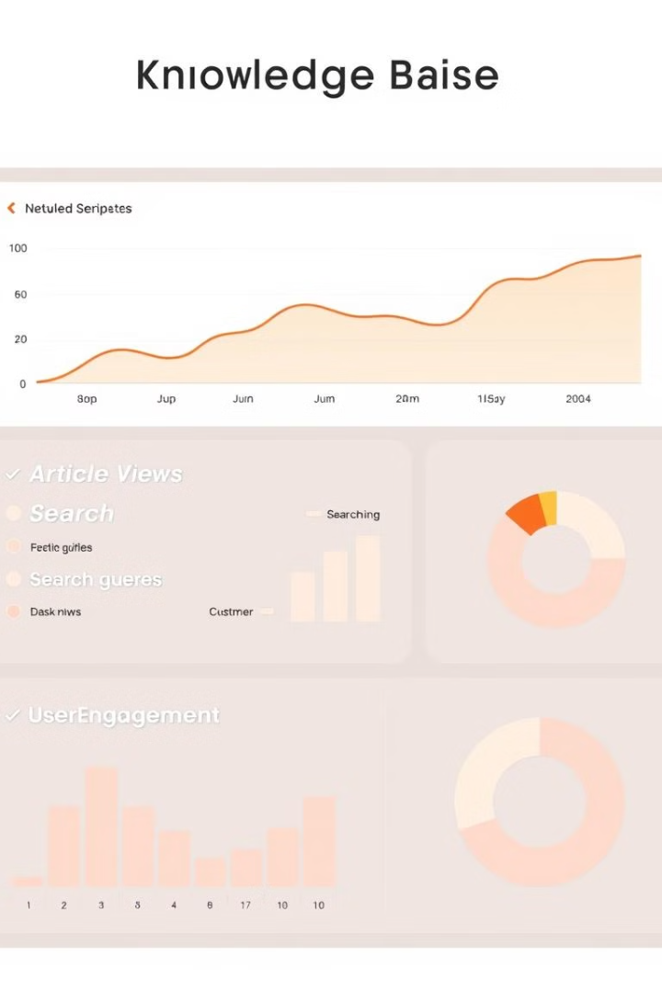
Key Metrics to Track
Metric
Description
Article Views
Number of times articles are accessed
Search Queries
Frequency and type of search queries used
User Engagement
Time spent on articles, ratings, and feedback provided
Support Ticket Reduction
Decrease in support inquiries due to knowledge base usage

Slide 5




Top Challenges in Implementation
Content Creation
Developing and maintaining high-quality, comprehensive content requires significant effort.
User Adoption
Encouraging employees to use the knowledge base effectively can be challenging.
Integration
Integrating the knowledge base with existing systems and workflows can be complex.

Slide 6

User Engagement and Adoption Rates
1
Onboarding
Provide comprehensive training and guidance to new users.
2
Gamification
Introduce gamified elements like badges and points to encourage participation.
3
Feedback and Recognition
Collect user feedback and acknowledge contributions to build a sense of community.

Slide 7
Content Curation and Maintenance
Regular Updates
Quality Control
Content Optimization
Ensure content is kept up-to-date with the latest information and changes.
Implement a process for reviewing and approving content to maintain accuracy.
Optimize content for readability, search engine optimization, and user comprehension.

Slide 8





Future Trends and Predictions
AI-Powered Knowledge Base
Mobile Accessibility
Cloud-Based Solutions
Voice Search Integration
Knowledge bases will become more accessible on mobile devices.
Cloud-based knowledge base platforms will dominate the market.
Voice search functionality will become a standard feature.
Artificial intelligence will play a larger role in automating content creation and personalization.

Slide 9

Conclusion
Enterprise knowledge bases are an essential tool for businesses looking to thrive in today's competitive landscape. By embracing the benefits of a knowledge base, organizations can empower their employees, improve customer experiences, and gain a competitive edge.

